Slide 1

Fraud Detection System For Bank Sector
By : Ikhlas.P and Sharon.J

Slide 2
Contents :
Project Description
About Our Model
Visualising Data
The EDA (The Exploratory Data Analysis)
Data!
Thank You - End

Slide 3

Project Description
Problem :
Bank frauds are the use of potentially illegal means to obtain money,assets or other property owned or held by a financial institution.
It reveals that fraud is costing the global economy £.89 trillion with losses rising by 56% in the past decade. - Crowe UK (Accounting Firm)

Slide 4

About Our Model
Our fraud detection system has the ability to prevent numerous frauds, such as - identity theft, accounting fraud etc by detecting illicit activity early in the process and ward off maximum damage to the banking sector.
How?
The system identifies the patterns and strategies through machine learning,statistical analysis and behaviour monitoring to prevent frauds without any human assistance.

Slide 5

Visualising Data
Visualising Data ::
Data visualisation is the practice of translating information into a visual context, such as common graphics - charts,plots,infographics and even animations, to make data easier to understand and pull insights from. The main goal of data visualization is to make it easier to identify patterns,trends and outliers in large datasets.

Slide 6
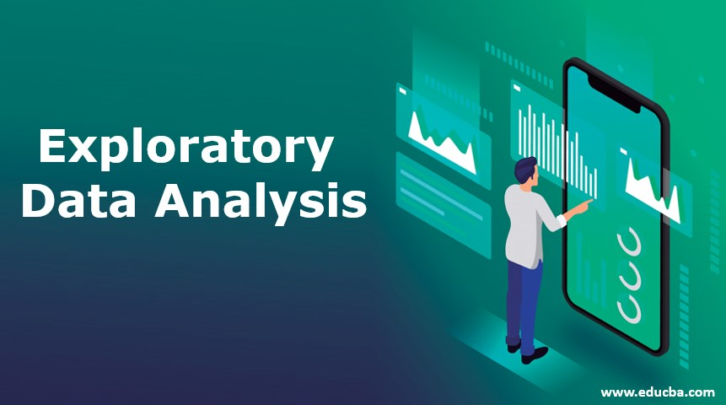
The EDA
Exploratory Data Analysis (EDA):
Exploratory data analysis (EDA) is the first step in the data analysis process.
It is an approach used by data scientists as a way of analyzing and investigating data sets for any anomalies for example to summarize their main characteristics, often using statistical graphics and other data visualization methods.
EDA can be performed in a series of steps.

Slide 7

Data!

Slide 8


